Slide 1



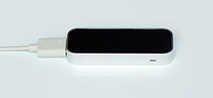
+
=
A lot of fun!

Slide 2
About
Scratch is a programming language
You can create:
Interactive stories
Animations
Games
Music
…

Slide 3
The art of programming
a program instructs the computer to do stuff
Add simple instructions together and..
magic happens (we hope…)

Slide 4
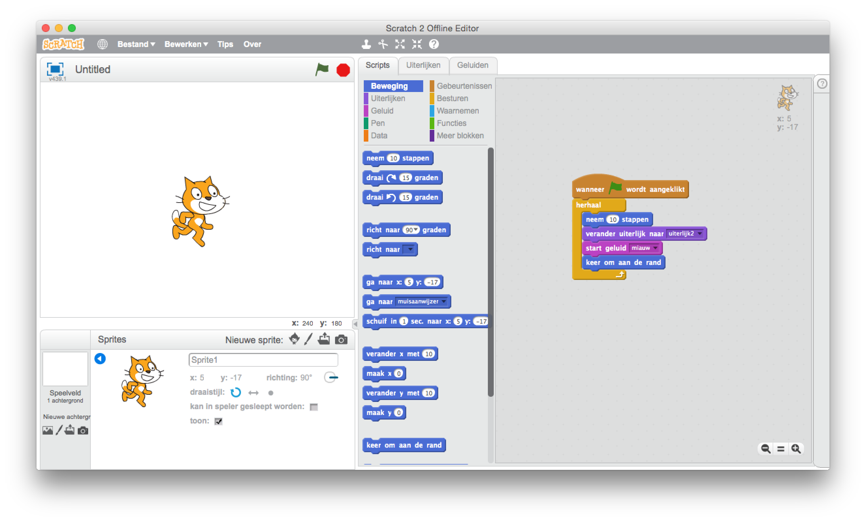
How? with building blocks

Slide 5
How? with building blocks

Slide 6
How? with building blocks

Slide 7
How? with building blocks

Slide 8
How? with building blocks

Slide 9
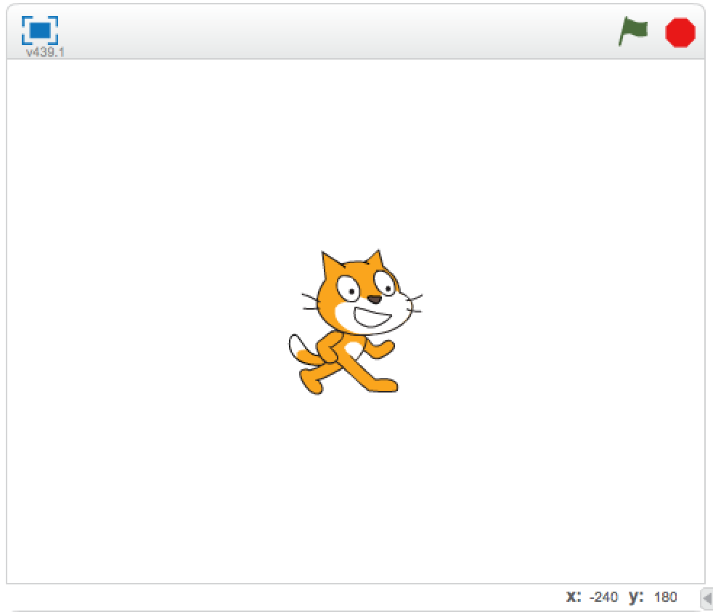
The stage
The stage is were your imagination comes to live
Sprites can:
move
talk to each other
interact

Slide 10


Sprites: your imaginative characters
You can place sprites on the play field like these:

Slide 11
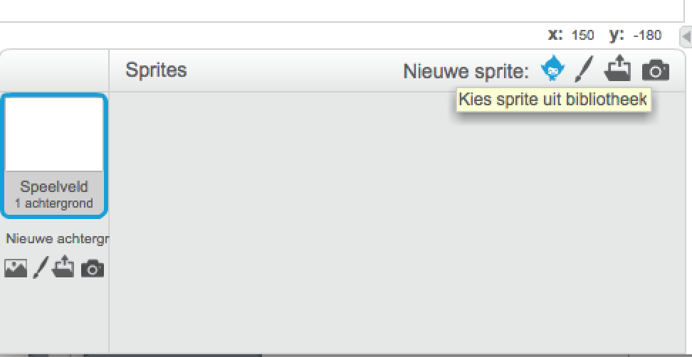
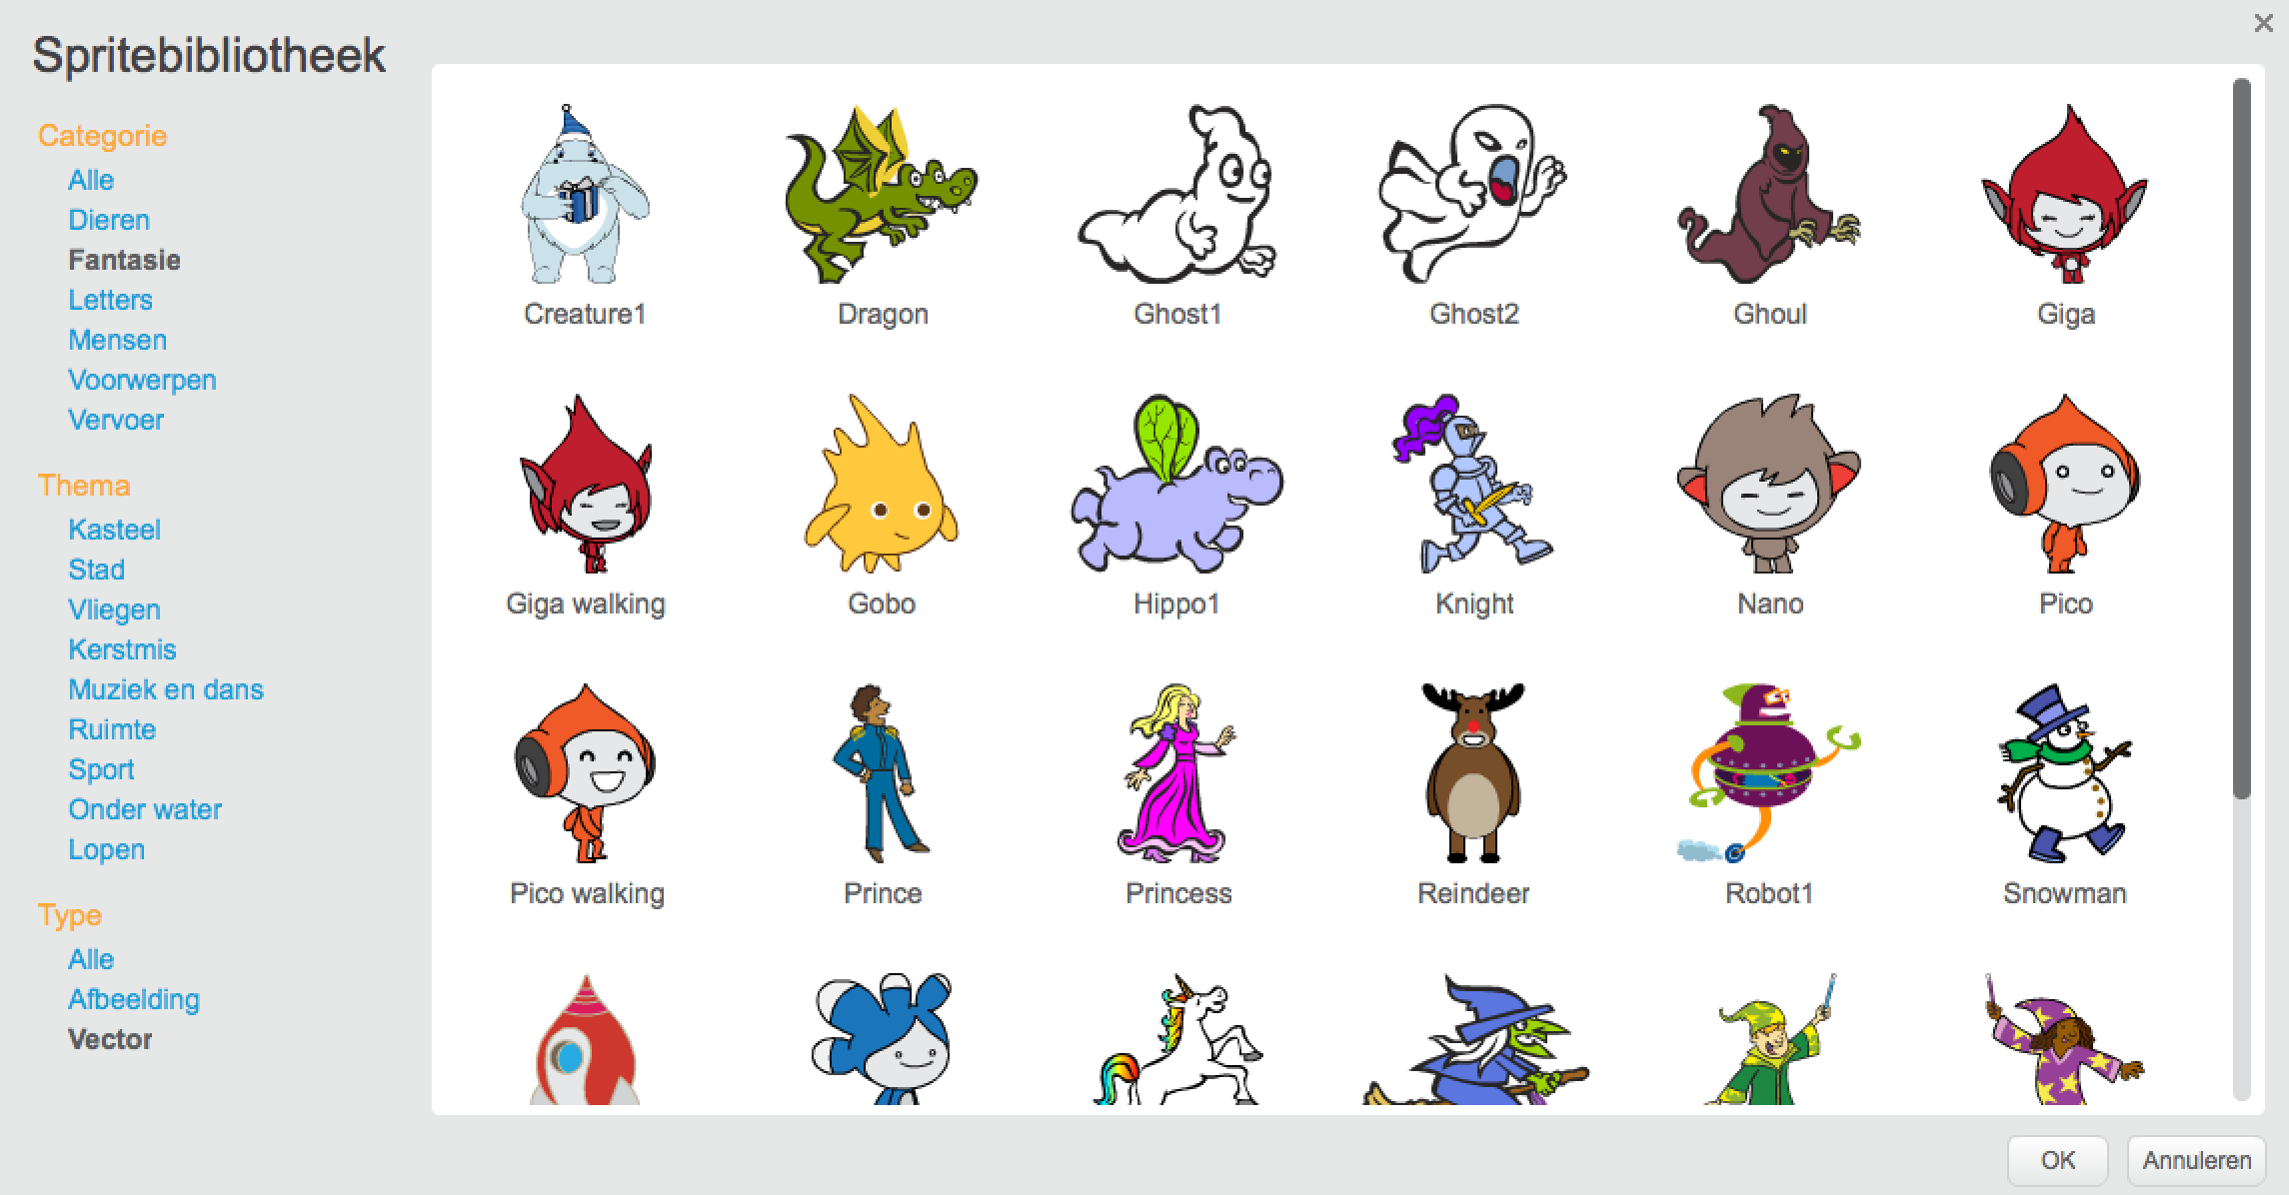
Sprites: choose your own
You can make your own or choose one from the library

Slide 12
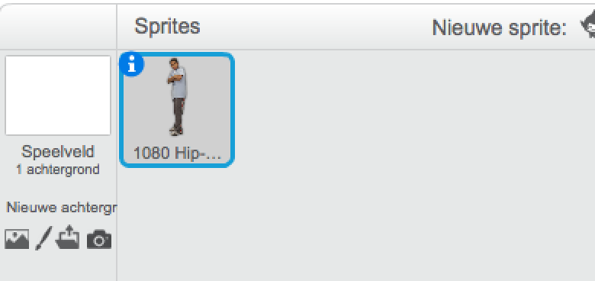
Sprite information
extra sprite information is hidden behind the image

Slide 13
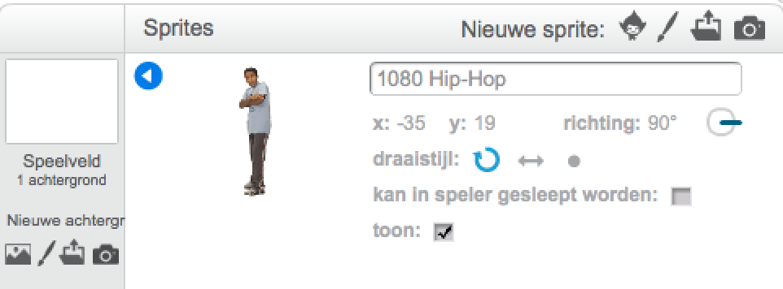
Sprite information
you can change the
name
position
movement
…

Slide 14
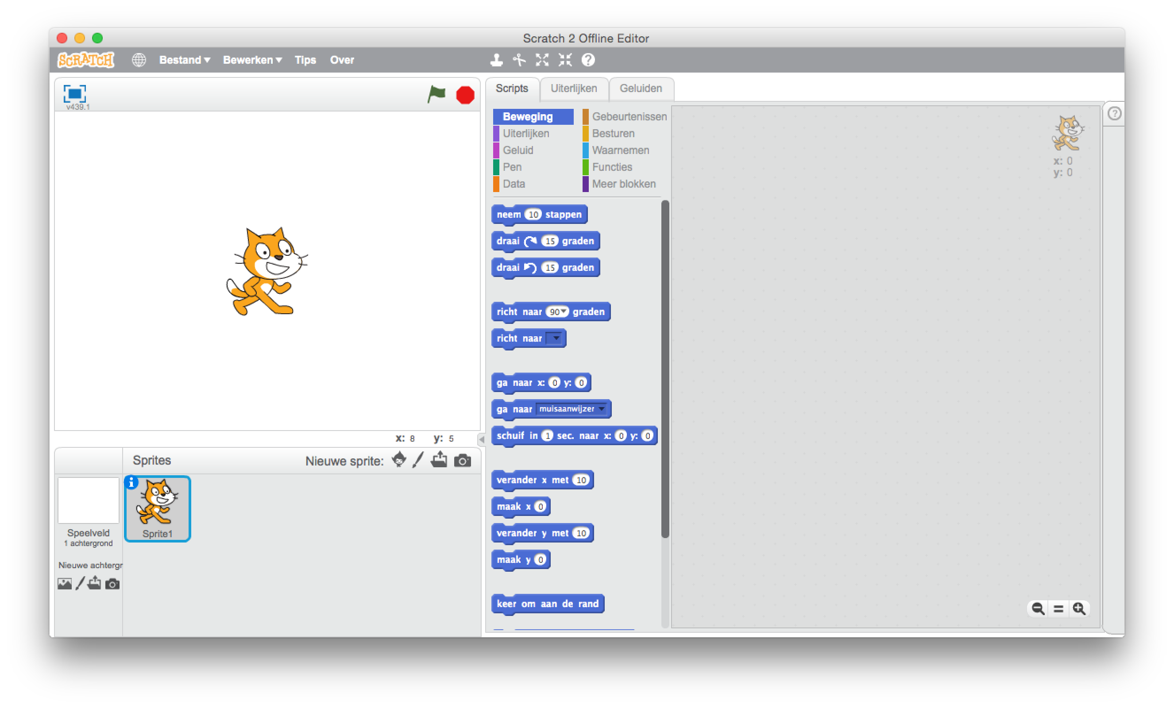
Task bar

Slide 15
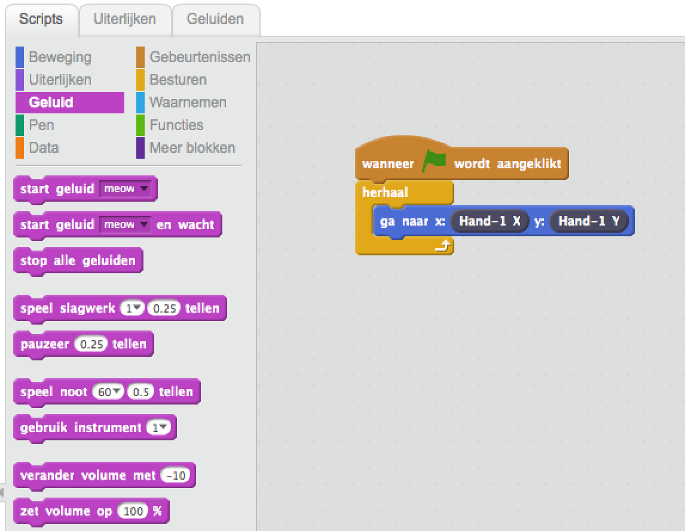
Programming
Drag and drop the building blocks into the execution area

Slide 16
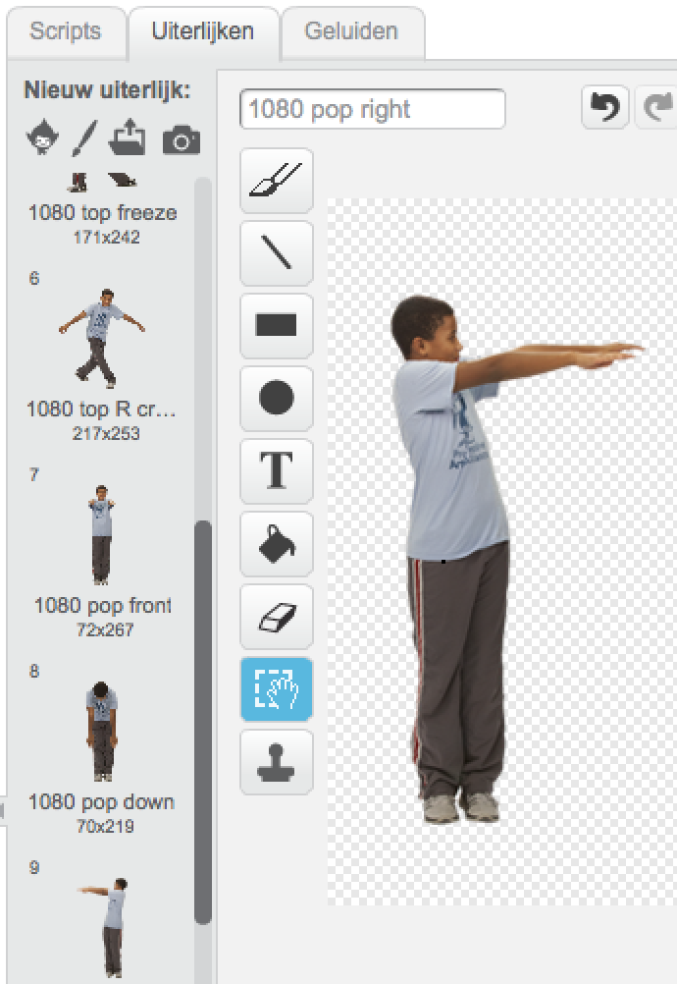
Costumes

Slide 17


run your program
Start
Stop

Slide 18
Imagine Create Share
https://scratch.mit.edu/

Slide 19
Leap motion

Slide 20
What is it?
Small device connected to your PC
It looks at your hands if you move them around the device
It determines the position of your hands and fingers

Slide 21
Leap Motion Demo

Slide 22
What can you do with it
Browse the internet
playing games
scale maps and images
draw
examine virtual 3D objects
…
…
use it with

Slide 23
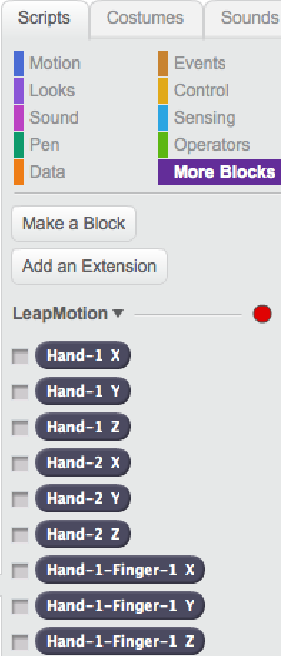
Leap motion building blocks

Slide 24
Let’s start!

Slide 25
Open ‘2 - Assignment 2.pdf’ and read the instructions

Slide 26
Order of assignments:
Assignment 2
Bongo Drum
Basketball
Diver
Balloon Pop

